Slide 1
Multi-Warehouse Stock Transfer Management System
DATABASE MANAGEMENT SYSTEM | PROJECT BASED LEARNING
WH-DEL
WH-MUM
A web-based database application for controlled, transaction-safe stock transfers across warehouses
Rutwik Reddy | 25WU0102231
B.Tech AIML (2025-29) | Section: Panthers
School of Technology, Woxsen University
WH-BLR
Notes:
Introduce yourself and the project. A DBMS project: one MySQL database controlling stock transfers between warehouses.

Slide 2
Problem Statement & Motivation
Manual problem | How the system helps
Stock inaccuracies | Stock updated automatically
Delayed transfers | Online approval queue
Poor visibility | Status tracking + in-transit quantity
Human errors | Validation and DB constraints
No history of movement | Transaction history + audit log
Scattered data | One central MySQL database
The problem
Manual transfer records give no reliable view of how much stock each warehouse holds, which transfers are pending or in transit, or who approved what.
The need: a central system that controls the whole transfer process and keeps quantities accurate automatically.
Notes:
Manual transfers use phone calls, paper slips and spreadsheets. Nobody knows real stock or what is in transit. Right column maps each problem to what the system does.

Slide 3
Objectives & Scope
1
2
3
4
Central database of warehouses, products and stock
Create transfer requests between warehouses
Validate stock before a transfer is accepted
Approve / reject step for authorised managers
5
6
7
8
Track status: Pending, Approved, In Transit, Received
Update source and destination stock safely using transactions
Keep full transaction history and audit log
Dashboards and reports for decisions
In scope Login with roles, masters, stock per warehouse, transfer life cycle, history, search, dashboard, reports, audit logs
Out of scope Purchase orders, billing, barcode / RFID, forecasting, mobile app, ERP
Notes:
Eight objectives; the system covers the full transfer life cycle but not purchasing, billing or barcode scanning.

Slide 4
System Architecture & User Roles
User
Browser
Frontend
HTML, CSS, JavaScript (fetch API)
Backend
Python Flask: routes, roles, validation
Database
MySQL 8.0, InnoDB, 10 tables
Role-based access control
Admin
Warehouse Manager
Inventory Staff
Viewer
Manages users, warehouses, products; sees all reports and audit logs
Approves or rejects transfers; dispatches and receives stock
Updates stock, creates transfer requests, dispatches and receives
Read-only view of stock, transfer status and reports
Notes:
Three-tier: browser, Flask backend, MySQL. Backend checks session, role and input before running SQL. Four roles with different powers.

Slide 5
Stock Transfer Life Cycle
Pending
Staff creates request; system validates stock
Approved
Manager approves
In Transit
Source dispatches goods
Received
Destination confirms receipt
No stock change
No stock change
Source stock decreases
Destination stock increases
Rejected / Cancelled
The manager can reject a Pending request, or the requester can cancel it. No stock is touched.
Transaction safety
Dispatch and Receive each run in one DB transaction: stock and status change together (COMMIT / ROLLBACK).
Notes:
Walk left to right. Stock only moves at Dispatch (leaves source) and Receive (enters destination), so goods in transit are never counted twice.

Slide 6
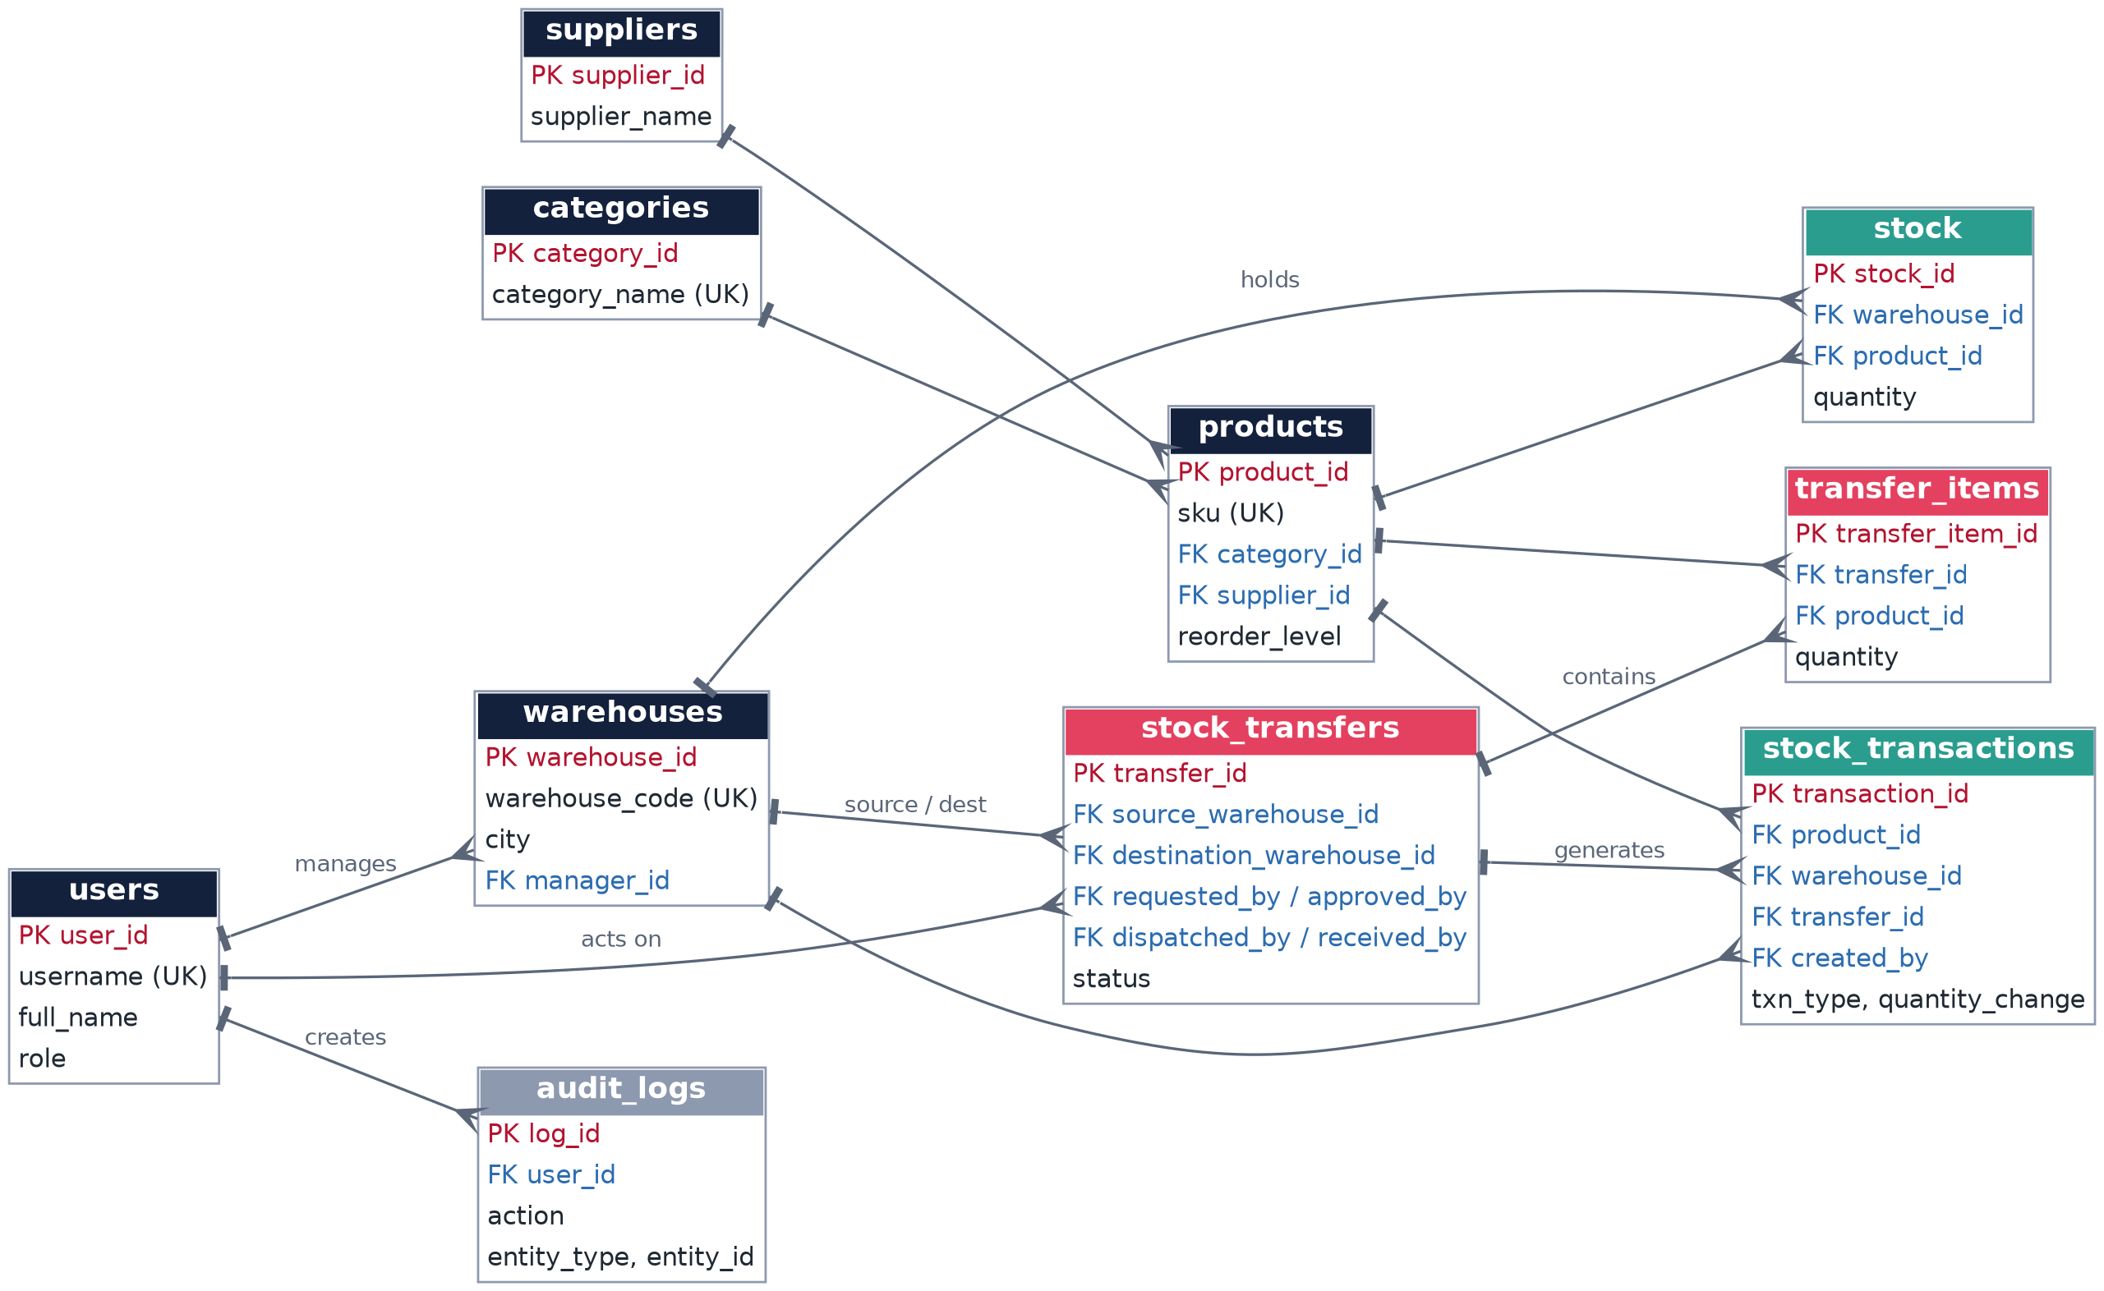
ER Diagram
10 entities, crow's foot at the many side
Warehouse and Product are M:N, resolved by stock
Transfer and Product are M:N, resolved by transfer_items
Navy: masters. Teal: stock records. Red: transfers
Notes:
Ten entities. Two many-to-many relationships are resolved by associative tables: stock and transfer_items.

Slide 7
Relational Schema: Master Tables
users
warehouses
categories
products
PK user_id
username
password_hash
full_name
email
role
is_active
created_at
PK warehouse_id
warehouse_code
warehouse_name
city
address
FK manager_id
is_active
PK category_id
category_name
description
PK product_id
sku
product_name
FK category_id
FK supplier_id
unit
reorder_level
suppliers
PK supplier_id
supplier_name
phone
email
Designed up to 3NF: category and supplier details live in their own tables, referenced by FK
Auto-increment INT primary keys; UNIQUE on username, email, warehouse_code, category_name, sku
1:N: one manager has many warehouses; one category / supplier has many products
Notes:
PK = primary key, FK = foreign key. Master data: users, warehouses, categories, suppliers, products.

Slide 8
Relational Schema: Stock & Transfer Tables
stock_transfers
stock_transactions
stock
audit_logs
PK transfer_id
transfer_code
FK source_warehouse_id
FK destination_warehouse_id
status
FK requested_by
FK approved_by
FK dispatched_by
FK received_by
request_date
approval_date
dispatch_date
received_date
remarks
PK transaction_id
FK product_id
FK warehouse_id
FK transfer_id
txn_type
quantity_change
FK created_by
created_at
PK stock_id
FK warehouse_id
FK product_id
quantity
last_updated
PK log_id
FK user_id
action
entity_type
entity_id
details
created_at
transfer_items
PK transfer_item_id
FK transfer_id
FK product_id
quantity
UNIQUE(warehouse_id, product_id) on stock | UNIQUE(transfer_id, product_id) on transfer_items | CHECK quantity >= 0, item quantity > 0, source <> destination | ENUM status
Notes:
Transactional tables. stock_transfers has four user FKs (requester, approver, dispatcher, receiver) and two warehouse FKs.

Slide 9
SQL: Database & Table Creation
CREATE DATABASE + CREATE TABLE stock
stock_transfers highlights
CREATE DATABASE IF NOT EXISTS warehouse_transfer_db
CHARACTER SET utf8mb4;
USE warehouse_transfer_db;
CREATE TABLE stock (
stock_id INT AUTO_INCREMENT PRIMARY KEY,
warehouse_id INT NOT NULL,
product_id INT NOT NULL,
quantity INT NOT NULL DEFAULT 0,
CONSTRAINT chk_stock_qty CHECK (quantity >= 0),
CONSTRAINT uq_stock UNIQUE (warehouse_id, product_id),
CONSTRAINT fk_stock_wh FOREIGN KEY (warehouse_id)
REFERENCES warehouses(warehouse_id),
CONSTRAINT fk_stock_prod FOREIGN KEY (product_id)
REFERENCES products(product_id)
) ENGINE=InnoDB;
status ENUM('PENDING',
'APPROVED','REJECTED',
'IN_TRANSIT','RECEIVED',
'CANCELLED')
NOT NULL DEFAULT 'PENDING',
CHECK (source_warehouse_id
<> destination_warehouse_id)
Ten InnoDB tables created parent-first: users, warehouses, categories, suppliers, products, stock, stock_transfers, transfer_items, stock_transactions, audit_logs.
Notes:
DDL with constraints. CHECK prevents negative stock, UNIQUE prevents duplicate stock rows, foreign keys keep references valid.

Slide 10
SQL: Joins, Aggregates & Reports
Q2: Products in a warehouse (JOIN)
Q7: Total stock by warehouse (GROUP BY)
SELECT p.sku, p.product_name,
c.category_name, s.quantity
FROM stock s
JOIN products p ON p.product_id = s.product_id
JOIN categories c
ON c.category_id = p.category_id
WHERE s.warehouse_id = 1
ORDER BY p.product_name;
SELECT w.warehouse_name,
COUNT(s.product_id) AS distinct_products,
COALESCE(SUM(s.quantity),0) AS total_units
FROM warehouses w
LEFT JOIN stock s
ON s.warehouse_id = w.warehouse_id
GROUP BY w.warehouse_id, w.warehouse_name
ORDER BY total_units DESC;
Q8: Low-stock products
SELECT w.warehouse_name, p.product_name, s.quantity, p.reorder_level
FROM stock s JOIN products p ON p.product_id = s.product_id
JOIN warehouses w ON w.warehouse_id = s.warehouse_id
WHERE s.quantity <= p.reorder_level
ORDER BY s.quantity ASC;
Notes:
Q2 uses joins, Q7 GROUP BY with LEFT JOIN so empty warehouses still show, Q8 feeds the low-stock report and dashboard card.

Slide 11
SQL: Creating & Viewing Transfers
Q3: Create a transfer request (with items)
Q1: Availability check
START TRANSACTION;
INSERT INTO stock_transfers (transfer_code,
source_warehouse_id, destination_warehouse_id,
requested_by, remarks)
VALUES ('TR-2025-0001', 1, 3, 3, 'Restock mouse');
SET @new_id = LAST_INSERT_ID();
INSERT INTO transfer_items
(transfer_id, product_id, quantity)
VALUES (@new_id, 2, 80), (@new_id, 3, 100);
COMMIT;
SELECT quantity
FROM stock
WHERE warehouse_id = 1
AND product_id = 2;
Request exceeds stock: "Insufficient stock", nothing saved.
Q4: Pending transfers (manager queue)
SELECT t.transfer_code, sw.warehouse_name AS from_wh,
dw.warehouse_name AS to_wh, t.request_date
FROM stock_transfers t
JOIN warehouses sw ON sw.warehouse_id = t.source_warehouse_id
JOIN warehouses dw ON dw.warehouse_id = t.destination_warehouse_id
WHERE t.status = 'PENDING' ORDER BY t.request_date;
Notes:
Application first checks availability with Q1 for every item. If any item exceeds stock, nothing is inserted. Request and items are inserted in one transaction.

Slide 12
SQL: Dispatch & Receive Transactions
Dispatch: stock leaves the source
Receive: stock enters the destination
START TRANSACTION;
SELECT status FROM stock_transfers
WHERE transfer_id = 1 FOR UPDATE;
UPDATE stock SET quantity = quantity - 80
WHERE warehouse_id = 1 AND product_id = 2
AND quantity >= 80;
INSERT INTO stock_transactions (product_id,
warehouse_id, transfer_id, txn_type,
quantity_change, created_by)
VALUES (2, 1, 1, 'TRANSFER_OUT', -80, 3);
UPDATE stock_transfers
SET status = 'IN_TRANSIT', dispatched_by = 3,
dispatch_date = NOW()
WHERE transfer_id = 1 AND status = 'APPROVED';
COMMIT;
START TRANSACTION;
INSERT INTO stock
(warehouse_id, product_id, quantity)
VALUES (3, 2, 80)
ON DUPLICATE KEY UPDATE
quantity = quantity + VALUES(quantity);
INSERT INTO stock_transactions (product_id,
warehouse_id, transfer_id, txn_type,
quantity_change, created_by)
VALUES (2, 3, 1, 'TRANSFER_IN', 80, 3);
UPDATE stock_transfers
SET status = 'RECEIVED', received_by = 3,
received_date = NOW()
WHERE transfer_id = 1
AND status = 'IN_TRANSIT';
COMMIT; -- on any error: ROLLBACK
Why transactions? Stock is never deducted without being added (or the reverse): every step succeeds together or nothing changes.
Notes:
Dispatch deducts from source; receive adds to destination with ON DUPLICATE KEY UPDATE. FOR UPDATE plus the status guard stop double processing.

Slide 13
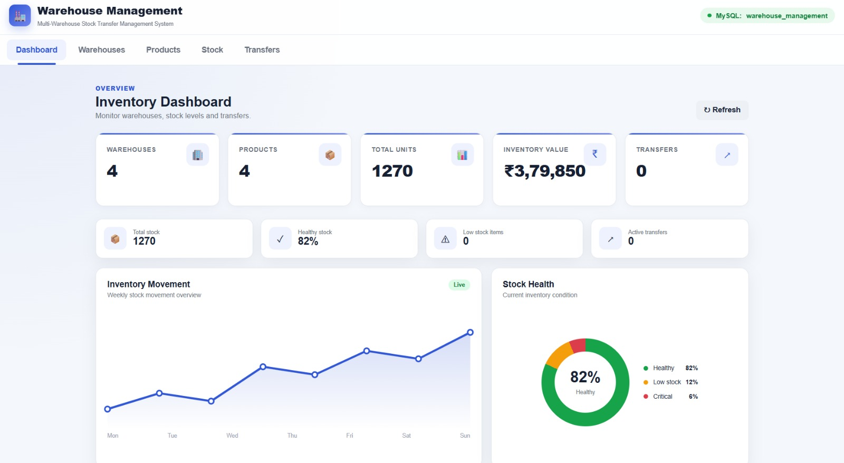
UI: Inventory Dashboard
Dashboard
Live summary cards: 4 warehouses, 4 products, 1,270 total units
Inventory value of ₹3,79,850 from aggregate queries
Stock health donut: 82% healthy, 12% low, 6% critical
Weekly inventory movement chart and active-transfer count
Connected to the MySQL database warehouse_management
Notes:
Dashboard from the running app: totals, inventory value, stock health and weekly movement.

Slide 14
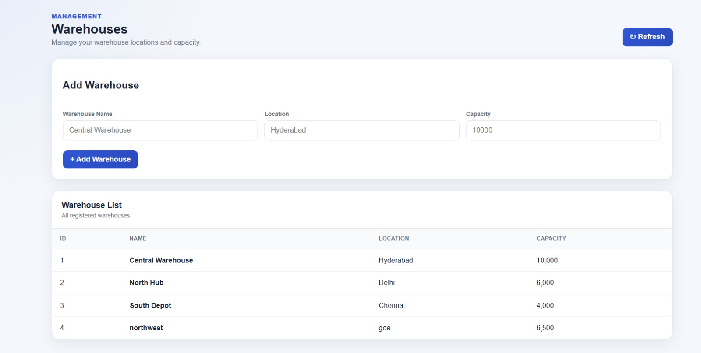
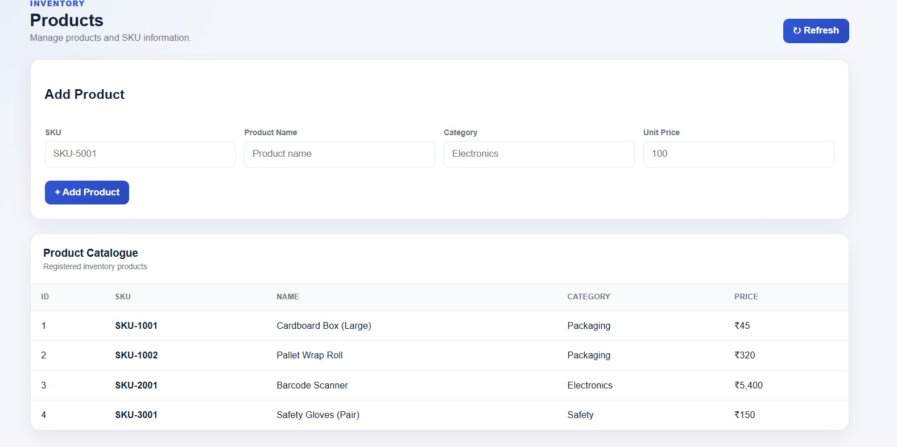
UI: Warehouse & Product Management
Warehouse management
Add warehouse with name, location and capacity
Warehouse list: Central (Hyderabad), North Hub (Delhi), South Depot (Chennai), northwest (Goa)
Product management
Add product with SKU, name, category and unit price
Catalogue of 4 products: packaging, electronics and safety items
Notes:
Warehouse and product management pages: add forms plus the list of registered records.

Slide 15
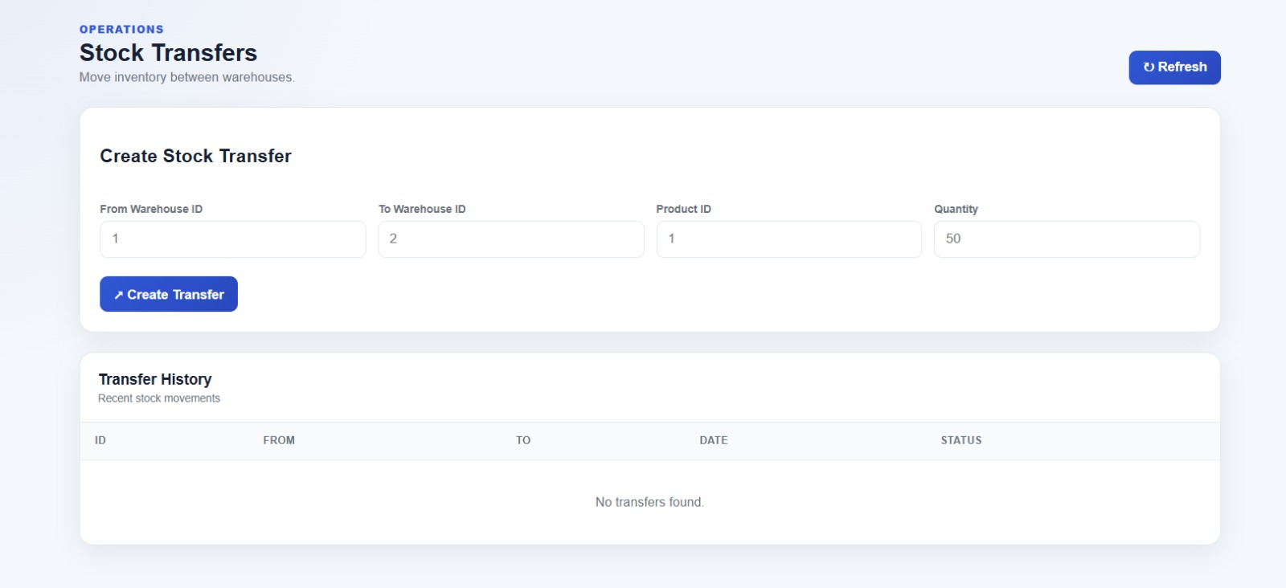
UI: Stock Transfers
Create stock transfer
Enter source warehouse, destination warehouse, product and quantity
Example: Warehouse 1 to Warehouse 2, Product 1, 50 units
Transfer History table lists ID, from, to, date and status
Empty at first (0 transfers) until a transfer is created
Notes:
Stock transfer page: create a transfer by warehouse IDs, product and quantity. History appears below.

Slide 16
Results: Sample Transfer & Test Cases
Test case | Expected result
TC08 Create transfer | Status PENDING
TC09 Insufficient stock | Error, nothing saved
TC16 Dispatch approved | Status IN_TRANSIT
TC17 Source stock | Delhi mouse 200 to 120
TC19 Destination stock | Bengaluru mouse 18 to 98
TC20 Receive twice | Error, stock not added again
TC24 Viewer approves | Access denied (HTTP 403)
25 test cases in total (Table 9.1)
Notes:
Sample transfer TR-2025-0001: Delhi to Bengaluru, 80 wireless mice. Source drops at dispatch, destination rises at receipt. Test results shown are the expected outcomes from Table 9.1.

Slide 17
Security, Advantages & Limitations
Security
Advantages
Limitations
Salted password hashes
Role-based access on every route
Parameterised queries stop SQL injection
Constraints and transactions
Audit logs and stock history
Centralised inventory
Real-time stock visibility
Automated transfer tracking
Fewer manual errors
Reports straight from SQL
Scalable normalised design
Needs network access
Relies on correct manual entry
No barcode / RFID
No forecasting or auto-reorder
No partial receipt or damage handling
Notes:
Security is layered: app checks plus database constraints. Be upfront about limitations: manual entry, no barcode, no partial receipts.

Slide 18
Conclusion & Future Scope
Conclusion
One MySQL database gives every user the same, current stock view
Request, approval, dispatch and receipt keep every transfer controlled
Transactions keep source and destination stock consistent
3NF design, constraints and audit logs improve accuracy and transparency
Future enhancements
Barcode, QR and RFID scanning
Mobile app for warehouse staff
Demand forecasting and reorder alerts
Email / SMS notifications
Partial receipt and damage handling
Cloud deployment and ERP integration
Thank you | Questions?
Notes:
Summarise: one source of truth, controlled lifecycle, transaction-safe updates, 3NF design. Then mention enhancements and invite questions.

